Slide 1



AI Master Class series – Day 25
AI Snake Game

Slide 2
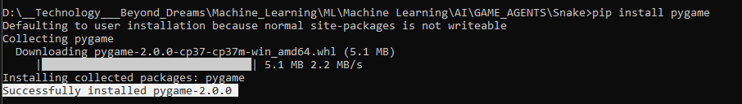
Installing Library
Pygame: pip install pygame

Slide 3
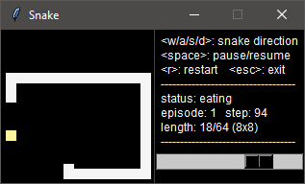
AI Snake Game
The single-player variant of Snake is a well-known and popular video game that requires a player to navigate a line-based representation of a snake through a two-dimensional playing area, while avoiding collisions with the walls of the playing area and the body of the snake itself.
A score and the snake length are increased whenever the snake is moved through items representing food.

Slide 4
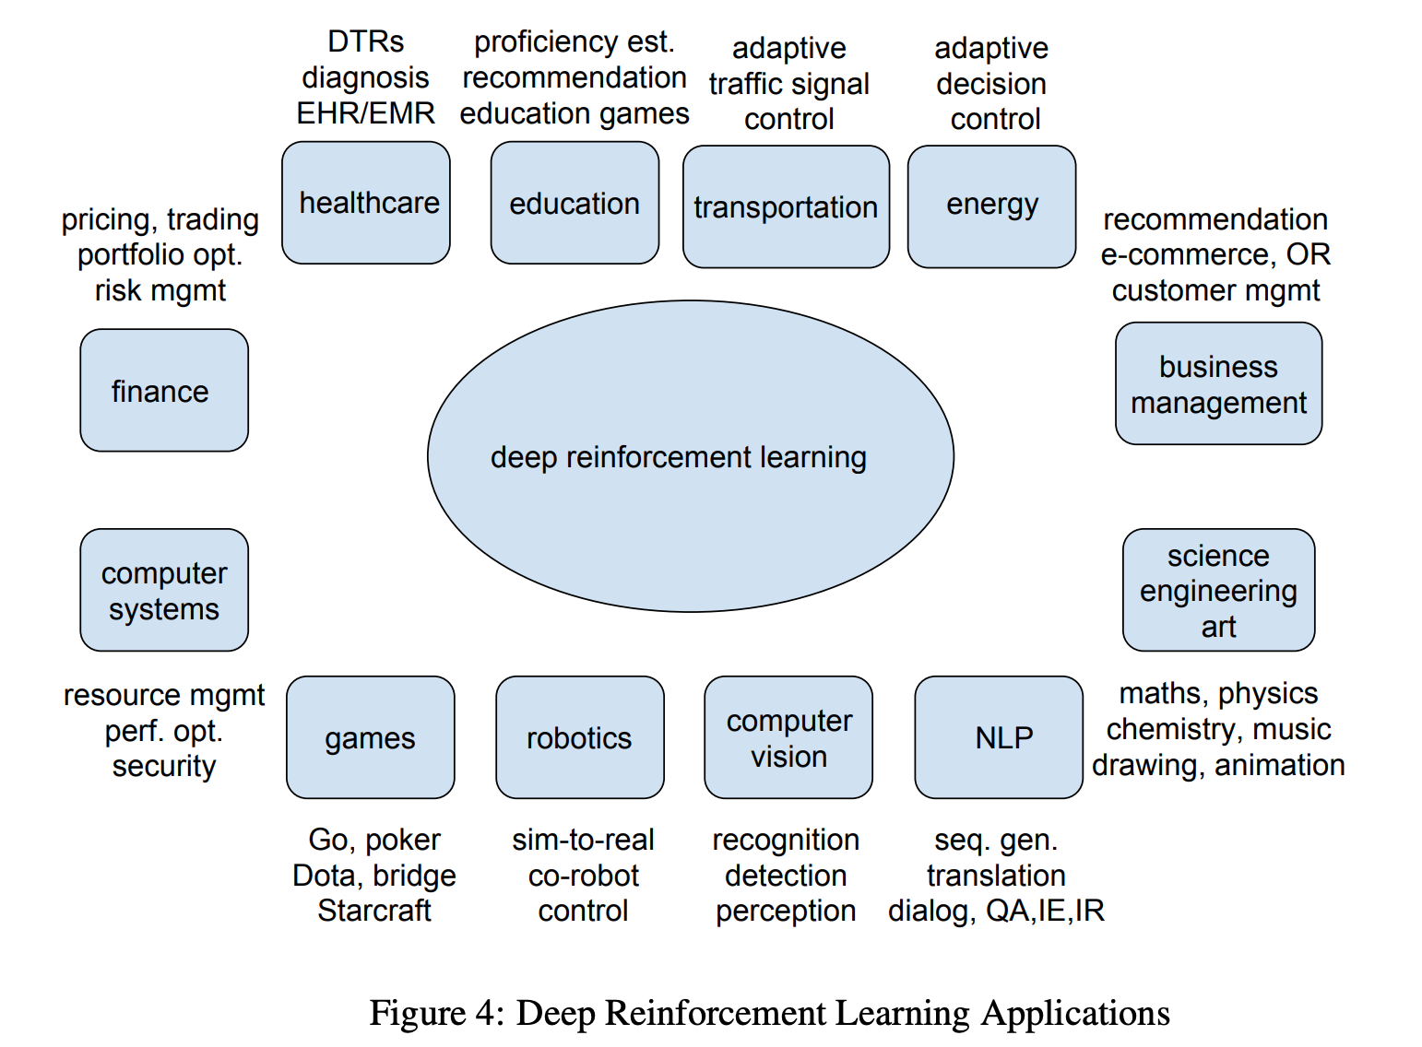
Reinforcement Learning
Reinforcement learning (RL) is an area of machine learning concerned with how software agents ought to take actions in an environment in order to maximize the notion of cumulative reward.
Reinforcement learning is one of three basic machine learning paradigms, alongside supervised learning and unsupervised learning.

Slide 5
Shortest Path - Path Solver
Path Solver uses breadth-first search to find the shortest path.
Intuitively, we expect the path to be as straight as possible so there will be less scattered empty points on the map.
The trick for implementation is that during each iteration, the adjacent point in the last traversed direction will be traversed first.

Slide 6
Longest Path - Path Solver
The longest path problem on the game map (i.e., a cyclic, undirected and unweighted graph) is NP-hard.
Path Solver uses a heuristic algorithm to find suboptimal solutions.
Suppose we want to find the longest path from point A to point B on a 4*4 game map.
The solver first finds the shortest path between the two points and then extends each pair of path pieces until no extensions can be found:

Slide 7
Greedy Path - Path Solver
A greedy algorithm is a simple, intuitive algorithm that is used in optimization problems.
The algorithm makes the optimal choice at each step as it attempts to find the overall optimal way to solve the entire problem.
It will choose what appears to be the optimal immediate choice, so it will choose 12 instead of 3 at the second step and will not reach the best solution, which contains 99.

Slide 8
Greedy Solver in Snake Game - Path Solver
The snake to eat the food along the shortest path if it thinks the snake will be safe.
Otherwise, it makes the snake wander around until a safe path can be found.
As it needs paths searching, it depends on [Path Solver]

Slide 9
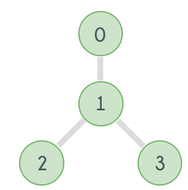
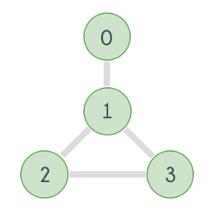
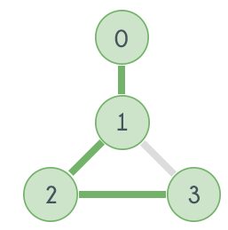
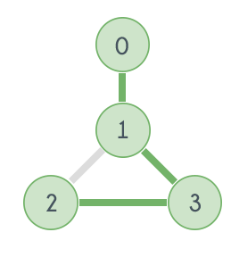
Hamiltonian Path - Path Solver
Hamiltonian Path is a path in a directed or undirected graph that visits each vertex exactly once.
The problem to check whether a graph (directed or undirected) contains a Hamiltonian Path is NP-complete, so is the problem of finding all the Hamiltonian Paths in a graph.

Slide 10
Hamilton solver in Snake Game - Path Solver
This builds a Hamiltonian cycle on the game map first and then directs the snake to eat the food along the cycle path.
To reduce the average steps the snake takes to success, it enables the snake to take shortcuts if possible.
Again, it depends on to find the longest path.

Slide 11
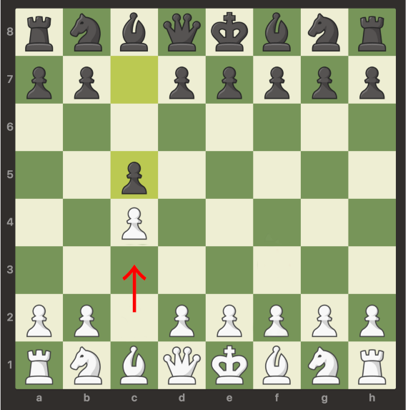
Deep QLearning
Qlearning
Q-learning learns the action-value function Q(s, a): how good to take an action at a particular state.
DQLN
A reinforcement learning algorithm that combines Q-Learning with deep neural networks to let reinforcement learning work for complex, high-dimensional environments, like video games, or robotics.

Slide 12

! PRACTICAL SESSION !

Slide 13
Manual Snake Game using Pygame

Slide 14
AI Snake Game

Slide 15

AI News – Day 25. MAY - 2020
“wacamole” (a single serving of waffle batter made with a sweet cornmeal mixture), “pileset” (form a mass of, or make a shape about, something), or “prayman” (the principal or leading men in a society or enterprise).
The website was developed by San Francisco-based developer Thomas Dimson, an engineer who used to work for the Facebook-owned Instagram developing its recommendations algorithm.

Slide 16
Thanks!
Tomorrow session
Natural Language Processing

Slide 17
Day-25 Agenda.
01.
02.
03.
AI Snake Game
Deep QLearning
Path Solver
04.
05.
AI Snake Game
Q & A
AI Snake game & Reinforcement Learning
Deep learning + Qlearning
Path solver algorithm
Manual & AI Snake Game

